Slide 1
Virtual Machines, Cloud, and Distributed Systems
Week 14

Slide 2
Virtual Machines
A virtual machine (VM) is a software version of a whole computer
A guest OS runs inside the VM, on top of the real computer, the host
  Like an apartment inside a building: each one has its own rooms and lock, but they share the same foundation and plumbing
The guest thinks it has its own processor, memory, drive, and network card (Week 13)
The software that runs VMs is called a hypervisor

Slide 3
Hypervisors
Type 1 (bare metal): the hypervisor is the operating system on the real hardware. Used in servers and data centers
  KVM, built into Linux, and Proxmox, which is built on it
  Microsoft Hyper-V and VMware ESXi
Type 2 (hosted): an app running on your normal OS. Used on laptops and desktops
  VirtualBox and VMware Workstation, and Parallels or UTM on Macs
Modern processors have built-in support (Intel VT-x and AMD-V), so VMs run nearly as fast as the real hardware
Notes:
Linux kernel documentation: KVM: https://docs.kernel.org/virt/kvm/index.html
Microsoft: Hyper-V virtualization: https://learn.microsoft.com/en-us/windows-server/virtualization/hyper-v/overview
VirtualBox: https://www.virtualbox.org/

Slide 4
What VMs Are Used For
Running another OS, like the Linux VMs used for labs in this course
Testing software or risky files safely, then throwing the VM away
Running many servers on one physical machine, which saves money and power
Keeping old software running on a newer computer
WSL2 runs a real Linux kernel in a lightweight VM on Windows
Historical note: Windows 7 included "XP Mode", a Windows XP VM for old programs, and Microsoft Virtual PC has been retired. Still worth knowing because the same idea, a VM for old software, is still common
Notes:
Microsoft: What is Windows Subsystem for Linux: https://learn.microsoft.com/en-us/windows/wsl/about

Slide 5
Virtual Machine Requirements
Fidelity: programs run the same in a VM as on a real computer
Performance: programs run at close to full speed
Safety: a program in one VM can't affect the host or other VMs
To do this, the hypervisor catches anything the guest OS tries to do directly to the hardware, and handles it safely
Special guest drivers (VirtualBox Guest Additions, for example) make the virtual disk, network, and screen faster

Slide 6
Snapshots, Shared Folders, and Networking
Snapshots save a VM at a moment in time, so you can roll back after a mistake (Week 10)
Shared folders let the guest and host share files
  Turning them off keeps the guest more isolated, which is safer for testing risky files
Networking: NAT, bridged, or host-only (Week 13)
A whole VM is just a few files, so it's easy to copy, back up, or move to another computer

Slide 7
Weaknesses of Virtual Machines
Each VM needs its own memory, drive space, and a full OS to update
Too many VMs on one host can slow everything down
VM escape: a rare but serious bug that lets a program break out of the guest into the host
Licensing can change overnight: after Broadcom bought VMware, it ended perpetual licenses and moved to subscriptions, raising costs for many companies
  Many moved to alternatives like Proxmox and Hyper-V
Notes:
Ars Technica: Broadcom ends VMware perpetual license sales: https://arstechnica.com/information-technology/2023/12/broadcom-ends-vmware-perpetual-license-sales-testing-customers-and-partners/
Proxmox Virtual Environment: https://www.proxmox.com/en/products/proxmox-virtual-environment/overview

Slide 8
Containers vs. Virtual Machines
A VM includes a whole guest OS. A container shares the host's kernel, and just packages the app and what it needs (Week 2)
  Containers start in seconds and use little memory
  VMs give stronger isolation, and can run a different OS than the host
Docker builds and runs containers. Kubernetes runs large numbers of them across many servers
  Like shipping containers: the same box fits on any ship or truck
In the cloud, containers often run inside VMs, to get the benefits of both
Notes:
Red Hat: Containers vs. VMs: https://www.redhat.com/en/topics/containers/containers-vs-vms
Docker: What is Docker?: https://docs.docker.com/get-started/docker-overview/
Kubernetes: Overview: https://kubernetes.io/docs/concepts/overview/

Slide 9
The Cloud
Cloud computing means renting computers you don't own, over the internet, and paying for what you use, like electricity
Underneath, it's huge data centers running hypervisors and containers
The biggest providers are Amazon Web Services, Microsoft Azure, and Google Cloud
Most cloud servers run Linux
Notes:
NIST SP 800-145: The NIST Definition of Cloud Computing: https://csrc.nist.gov/pubs/sp/800/145/final

Slide 10
Cloud Service Models
IaaS (infrastructure as a service): rent a virtual server and manage the OS yourself
PaaS (platform as a service): upload your app, and the provider runs the OS and servers
SaaS (software as a service): just use the app, like Google Docs, Microsoft 365, or your school's learning system
Serverless: upload a small function that runs only when needed. There are still servers, you just never see them
Like housing: IaaS is renting an empty apartment, PaaS is a furnished one, and SaaS is a hotel

Slide 11
Weaknesses of the Cloud
Outages can take down many companies at once
  In October 2025, an AWS bug left DynamoDB with an empty DNS record in its busiest region, and apps such as Snapchat and Slack went down for hours
Costs can grow quickly, and moving away from one provider is hard (lock-in)
You share hardware with strangers, and you depend on the provider's security
Your data may be stored in another country, under different laws
Notes:
AWS: Summary of the DynamoDB service disruption: https://aws.amazon.com/message/101925/

Slide 12
Data Centers and Energy
Data centers used about 1.5% of the world's electricity in 2024
The IEA expects that to more than double by 2030, driven mostly by AI
Operating systems help by putting idle cores to sleep, packing VMs and containers onto fewer servers, and turning off unused machines
Edge computing: process data close to where it's made, in phones, cars, and IoT devices, instead of sending everything to a data center (Week 13)
Notes:
IEA: Energy and AI: https://www.iea.org/reports/energy-and-ai/executive-summary
IBM: What is edge computing?: https://www.ibm.com/think/topics/edge-computing

Slide 13
Different Jobs, Different Operating Systems
Personal computers and phones: a GUI, one main user, frequent updates, and battery life matters
Servers: often no screen at all, managed remotely over the network, serving thousands of users, and expected to run for months or years without rebooting
NAS boxes: a stripped-down OS whose main job is storing and sharing files (Week 10)
Data center hosts: a hypervisor or minimal container OS, managed by software rather than people
Embedded, phones, and cars: built for one device, with the maker controlling updates (Weeks 1 and 13)

Slide 14
Server Operating Systems
Servers favor stability over new features, so they use long-term support releases
  Red Hat Enterprise Linux: 10 years of support for each major version
  Ubuntu LTS: a new long-term release every 2 years, with 5 years of standard security updates
  Windows Server LTSC: 5 years of mainstream and 5 of extended support
Usually installed without a GUI, and managed with the command line and automation tools
IBM mainframes still run z/OS and Linux for banks and airlines (Week 1)
Notes:
Red Hat: RHEL life cycle: https://access.redhat.com/support/policy/updates/errata
Ubuntu: Release cycle: https://ubuntu.com/about/release-cycle
Microsoft: Windows Server servicing channels: https://learn.microsoft.com/en-us/windows-server/get-started/servicing-channels-comparison
IBM Z: https://www.ibm.com/products/z

Slide 15
NAS and Data Center Operating Systems
NAS operating systems are managed through a web page, and focus on storage, RAID, snapshots, and sharing
  TrueNAS, built around the ZFS file system (Week 9)
  Synology's DiskStation Manager, which is Linux-based
Container-focused operating systems are tiny and update themselves as a whole, so there is less to attack
  Fedora CoreOS, and Amazon's Bottlerocket
Hypervisor hosts run Proxmox, Hyper-V, VMware ESXi, or KVM on Linux
Notes:
TrueNAS Community Edition: https://www.truenas.com/truenas-community-edition/
Synology: DiskStation Manager: https://www.synology.com/en-us/dsm
Fedora CoreOS: https://fedoraproject.org/coreos/
AWS: Bottlerocket: https://aws.amazon.com/bottlerocket/

Slide 16
Distributed Systems
Many computers working together over a network, so that users feel like they are using one machine
Computing and storage are spread across many machines
Examples you use every day: search engines, streaming services, online games, and cloud storage
Goals: performance, scalability, reliability, and working even when some machines fail
Notes:
IBM: What are distributed systems?: https://www.ibm.com/think/topics/distributed-systems

Slide 17
Why Distributed Systems Are Hard
No shared memory: computers coordinate only by sending messages over the network (Week 2)
No shared clock: each computer's clock is slightly different, so "what happened first" is tricky
Mutual exclusion has to be done with messages instead of shared locks (Week 6)
Parts can fail, or the network can split, at any moment
The system must keep working anyway, and agree on what the data is

Slide 18
Consistency Trade-offs
When data is copied to many servers around the world, the copies can briefly disagree
  Like the number of likes on a post showing differently on your phone and your laptop for a few seconds
The CAP theorem: when the network splits, a system has to choose between staying fully consistent and staying available
  A bank picks consistency. A social media feed picks availability
Notes:
IBM: What is the CAP theorem?: https://www.ibm.com/think/topics/cap-theorem

Slide 19
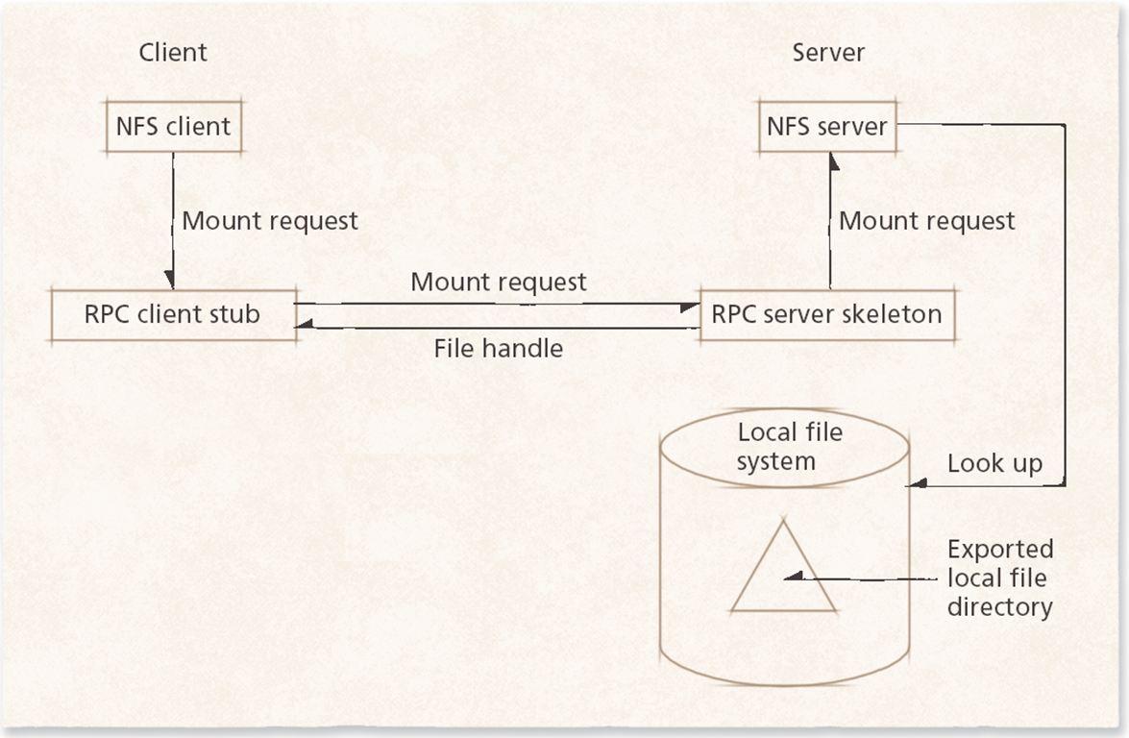
Distributed File Systems
Share files across many computers, as if they were on one drive
NFS mounts a folder from another computer (Weeks 9 and 13)
Large systems spread files across many servers, and keep copies in case one fails
Cloud storage like OneDrive and Google Drive is a distributed file system you use every day
Notes:
Linux kernel documentation: NFS: https://docs.kernel.org/filesystems/nfs/index.html

Slide 20
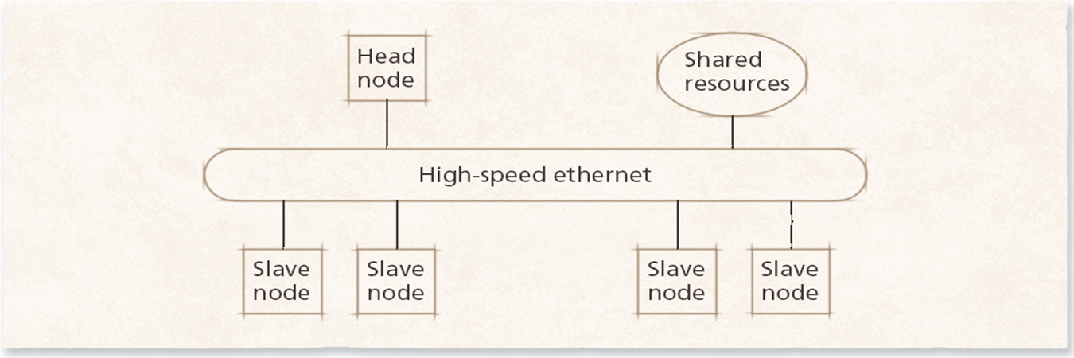
Clusters
A cluster is a group of computers that work together as one system
High-performance: every computer works on one big job, like supercomputers (Week 1)
High-availability: backup computers take over if one fails
A head node hands out the work, and worker nodes do it. The picture uses the older term "slave nodes"
  You may hear these called master and slave nodes. We use head and worker instead, because the old terms come from slavery and can make people feel unwelcome, and the new terms describe the job just as clearly
Notes:
IBM: What is high-performance computing?: https://www.ibm.com/think/topics/hpc

Slide 21
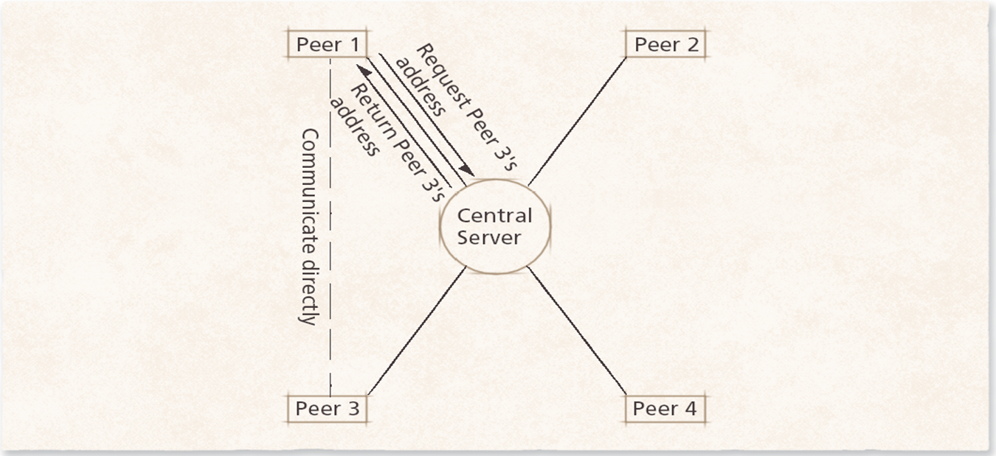
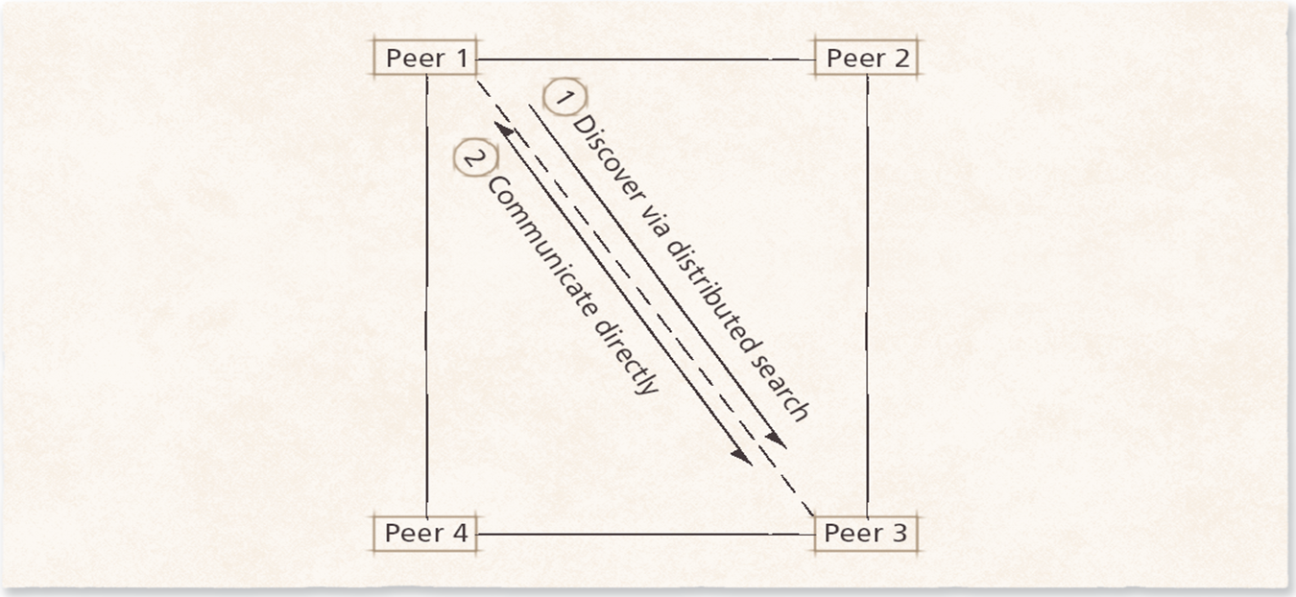
Peer-to-Peer
Every computer (peer) is both a client and a server
Centralized: a server helps peers find each other, then they connect directly
Pure: no server at all. Peers find each other by asking around, which can be slow
Examples: BitTorrent, some game updates, and video calls that connect directly
Notes:
BitTorrent: Protocol specification: https://www.bittorrent.org/beps/bep_0003.html

Slide 22
Grid and Volunteer Computing
A grid connects computers in different places, often owned by different groups, to work on one big problem
Volunteer computing: people donate their computer's spare time
  Folding@home studies how proteins fold, to understand diseases
  BOINC runs many science projects this way
Historical note: many earlier projects, like Docking@Home, have finished. Still worth knowing because the same idea powers research today
Notes:
Folding@home: https://foldingathome.org/
BOINC: https://boinc.berkeley.edu/

